Slide 1
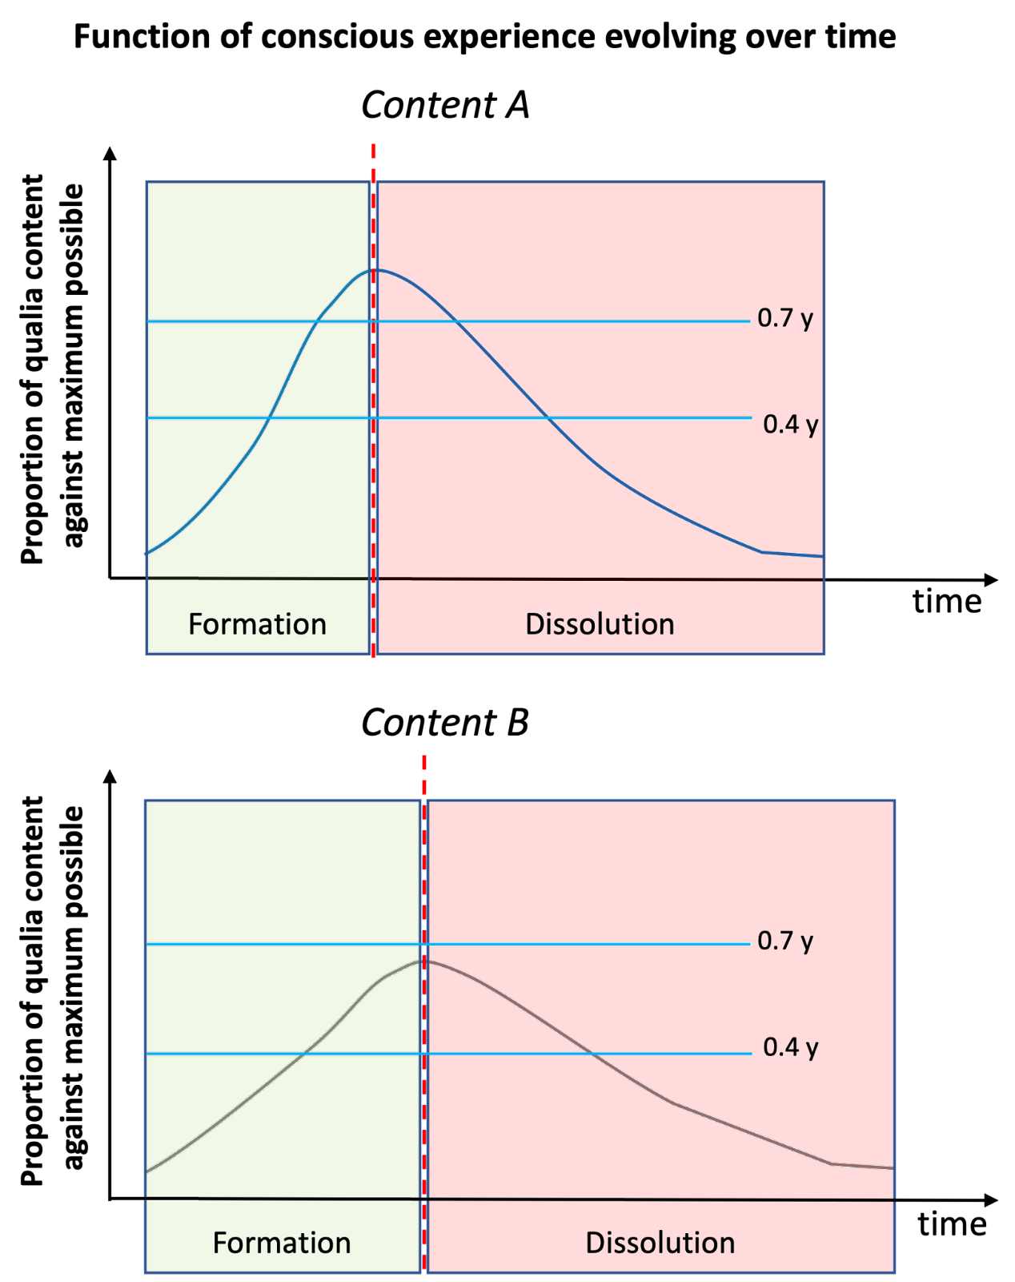

Slide 2
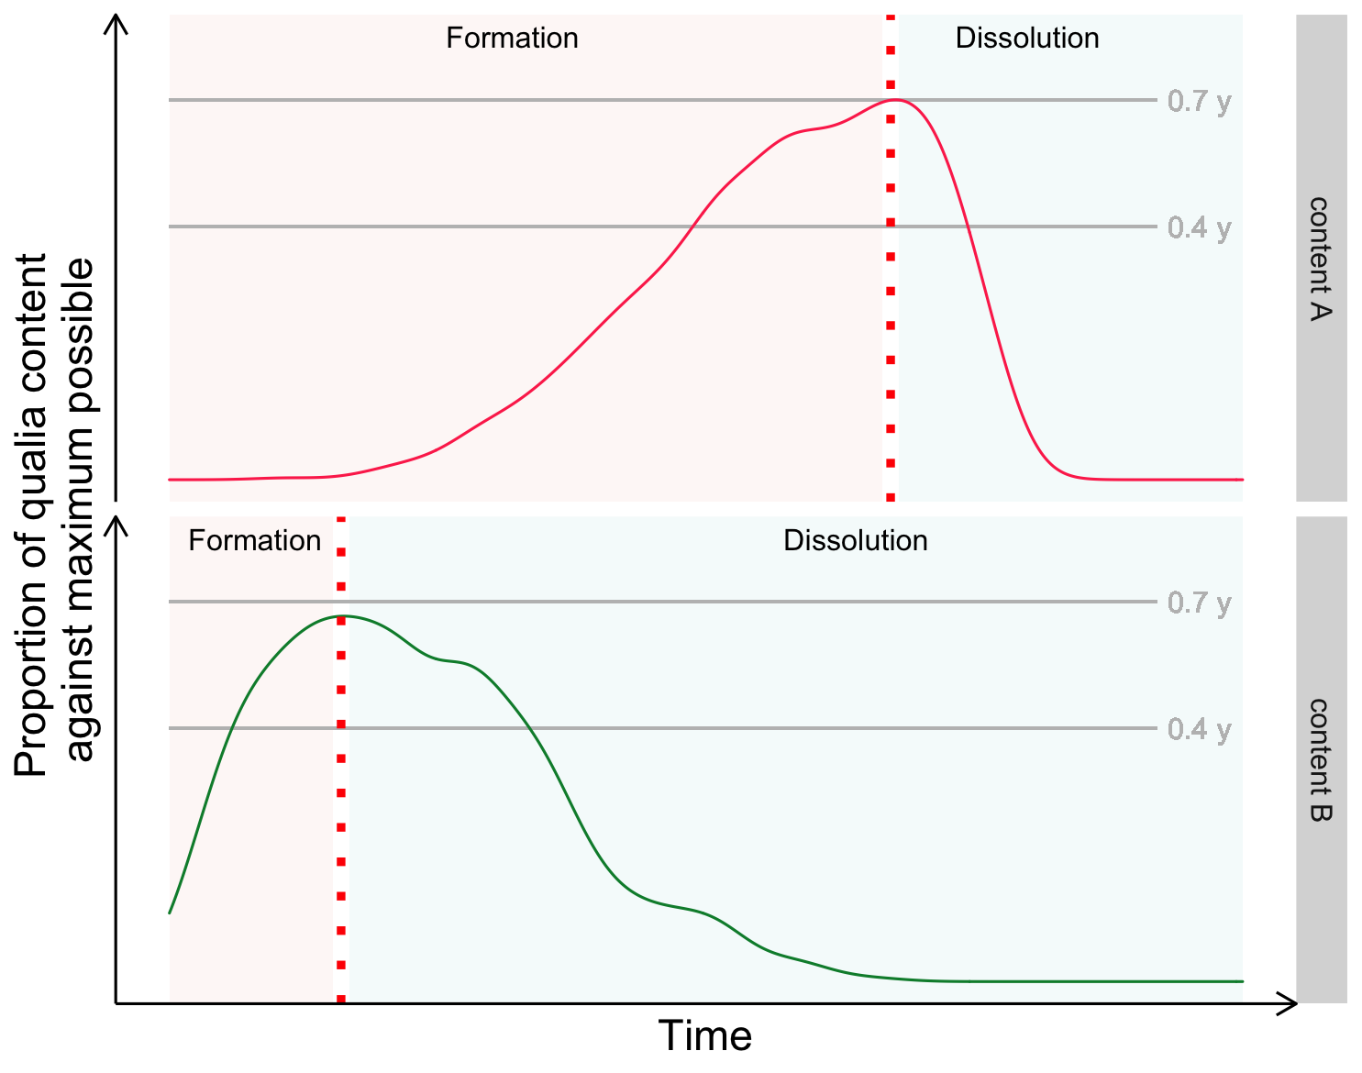

Slide 3
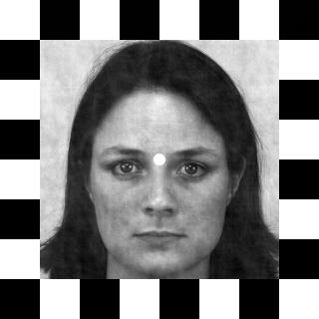
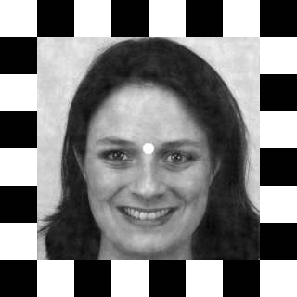
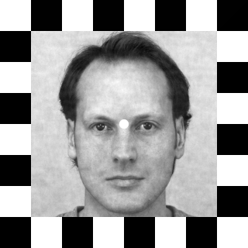
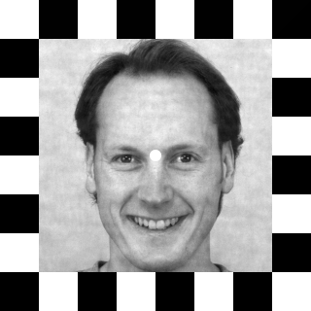
Emotion rivalry
Gender rivalry
Left eye
Right eye
Left eye
Right eye
Neutral
Happy
Female
Male
Female
Neutral
Happy
Neutral
Male
Female
Female
Neutral
Neutral
Happy
Male
Female
Male
Happy
Happy
Neutral
Female
Male
Male
Happy

Slide 4
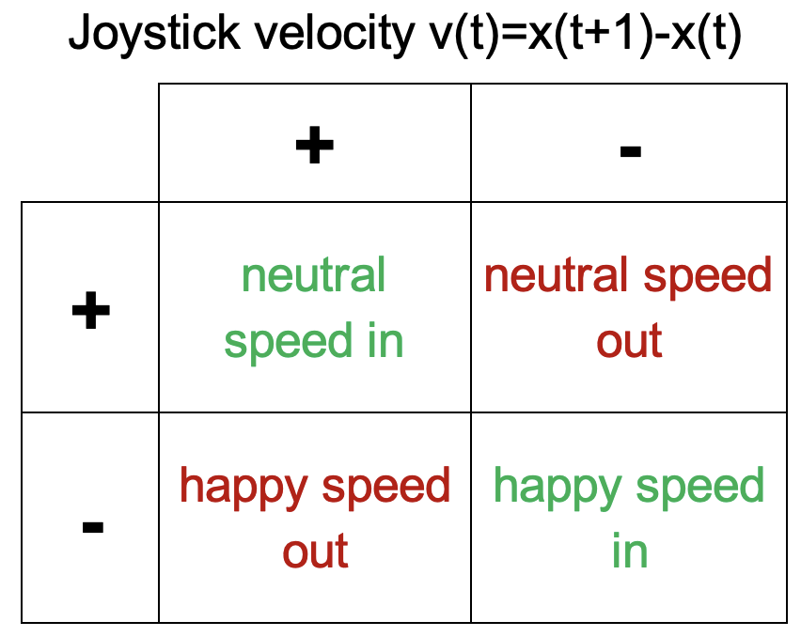
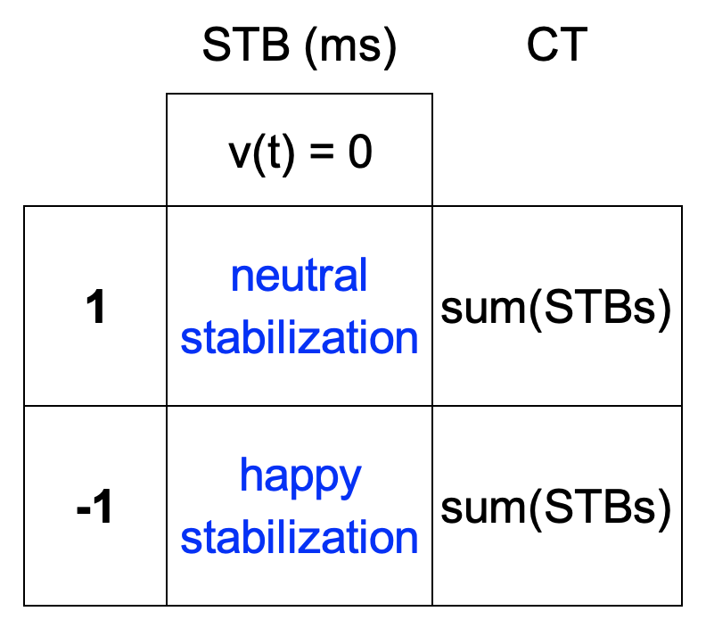
A) Data time series from a real trial of the emotion rivalry condition
Joystick position
Trial duration (ms)
B) Speed in/out
C) Stabilization
Joystick position
Joystick position

Slide 5
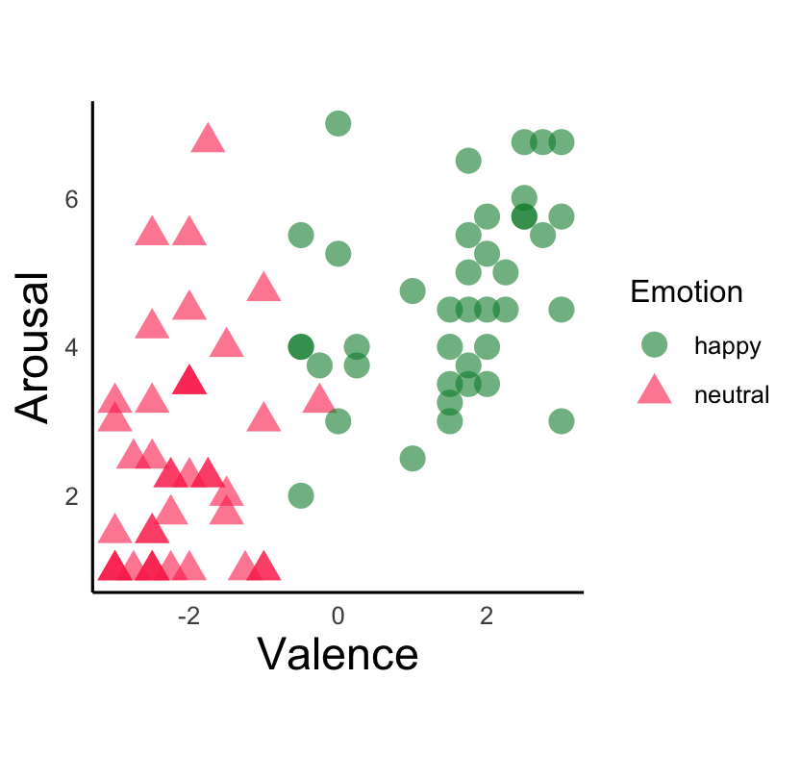

Slide 6
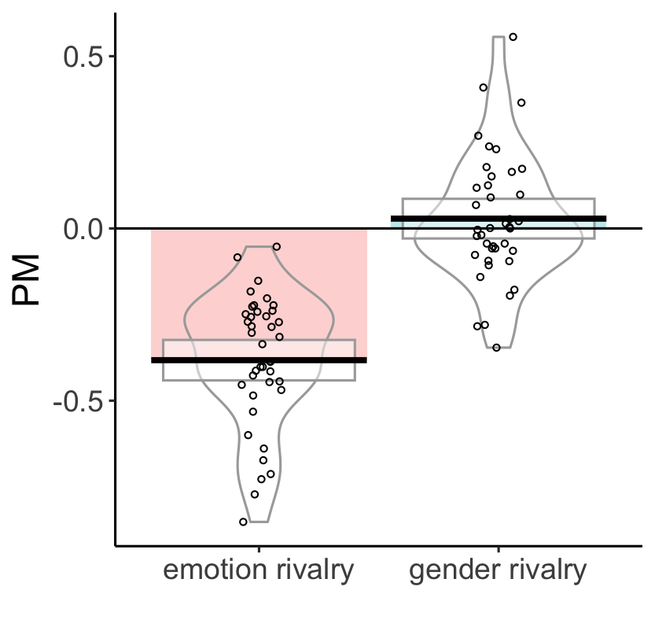
Mean of predominance

Slide 7
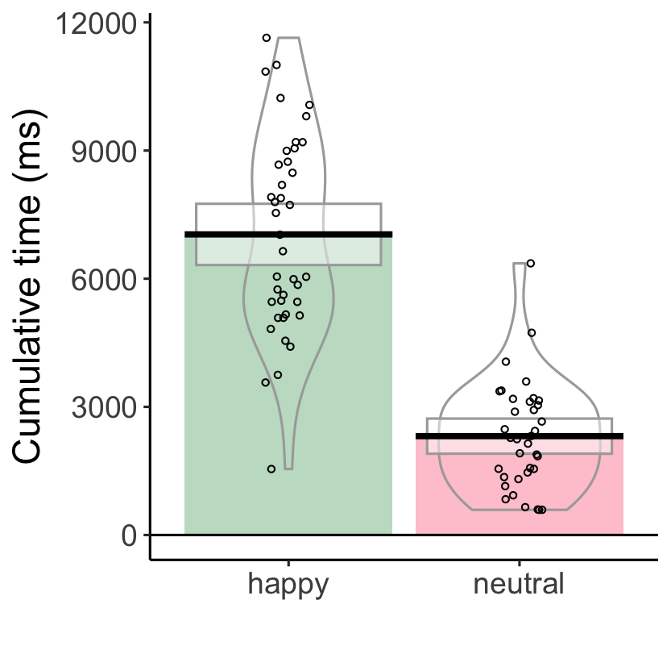
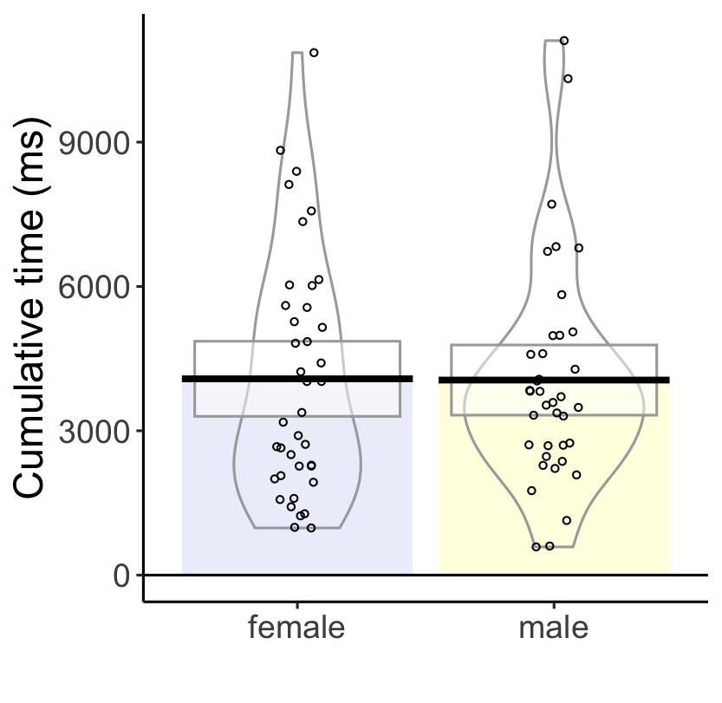
A) Emotion cumulative time
B) Gender cumulative time
***

Slide 9
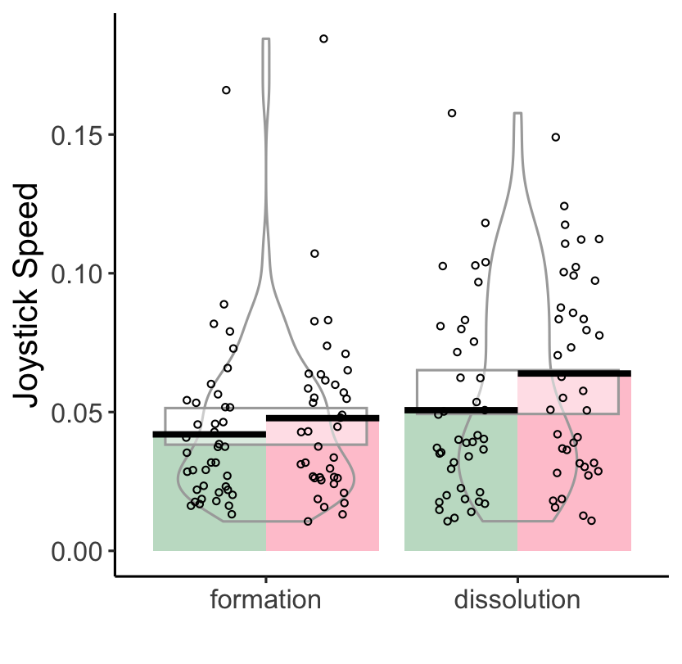
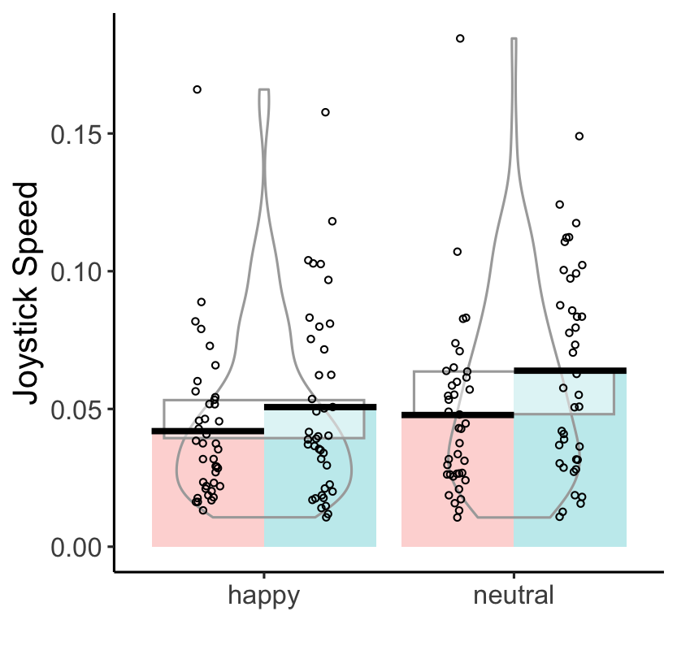
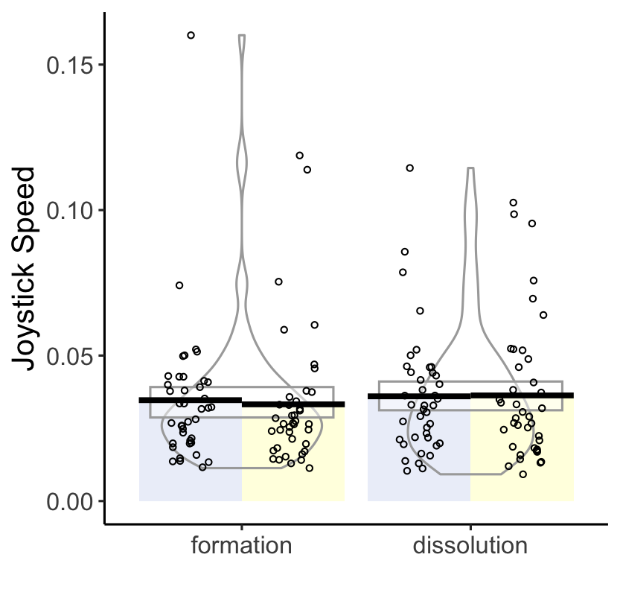
A) Main phase effect and interactions in emotion rivalry
B) Main emotion rivalry effect
***
***
**
***
***
**
Joystick speed
happy
neutral
happy
neutral
formation
dissolution
formation
dissolution
C) Main phase effect in gender rivalry
*
female male
female male

Slide 10
Main phase effect and interactions in emotion rivalry
B) Main phase effect in gender rivalry
***
**
***
*
***
**
Joystick speed
happy
neutral
happy
neutral
female male
female male

Slide 11
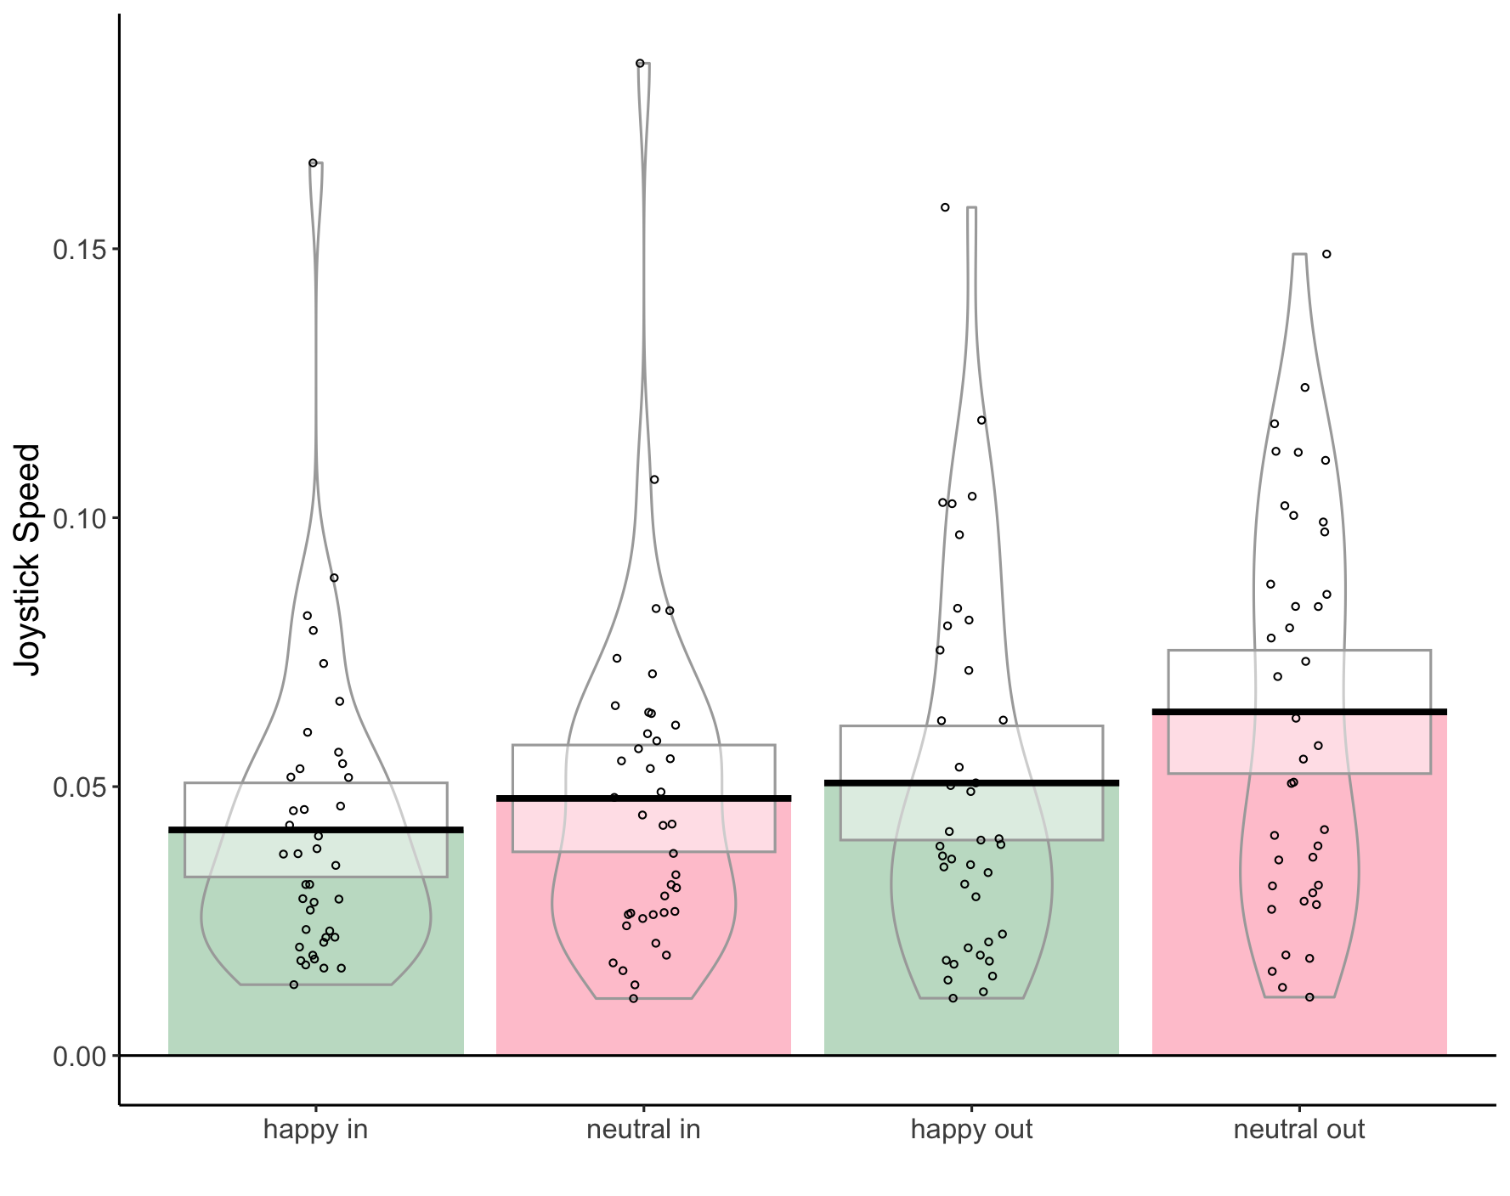
**
***
***
***
Joystick speed

Slide 12
*
female male
female male

